Slide 1
MINI MARKET PRODUCT ANALYSIS
A
PRESENTATION ON

Slide 2
CONTENTS :
INTRODUCTION
PROBLEM STATEMENT
PURPOSE OF PROJECT
WHO WILL BE IMPACTED BY THIS ANALYSIS
ANALYSIS ON DATA
CONCLUSION

Slide 3
INTRODUCTION
A mini market is a self service shop offering a wide variety of food, beverages and household products, organised into sections.
This kind of store is larger and has wider selection than earlier grocery stores, but is smaller and more limited in the range of merchandise thgan a hyper market or big-box market.
It typically has places fresh meat , fresh produce, dairy , dely items, baked goods etc...
Shelf space is also reserved for canned and packaged goods and for various non-food items such as kitchenware, household cleaners, pharmacy products and pet supplies.

Slide 4
PROBLEM STATEMENT
Lost sales and income
Delayed sales or income
Increased expenses ( e.g.,overtime labor, outsourcing, expenditing costs,etc,)
Regulatory fines or contractual penalties or loss of contractual bonuses
Customer dissatisfaction or defection
Delay of new bussiness plan
Timing and disruptions
The point in time when a bussiness function or process is disrupted can having a significant breaking on the loss sustained.
Interruption of the supply chain including failure of a suplier or disruption of transportation of goods from he supplier.

Slide 5
PURPOSE :
To solve the year wise and month wise total sales.
To show the top 10 products with highest sale across all 3 years.
To show the lowest sales of the products across the years.
To understand the relation b/w the products and sales.
To understand the sales of different catogeries of products.

Slide 6
SOME OF THE TYPES OF STAKEHOLDERS.
Managers
Distributors
Investors
Marketers
Sales department
Consumer service
Production team

Slide 7
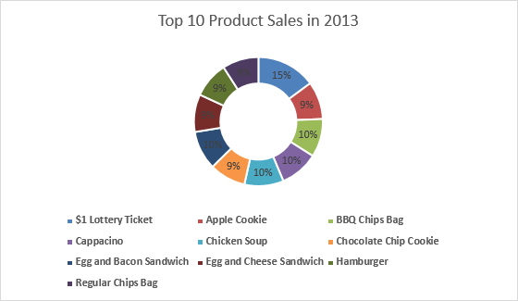
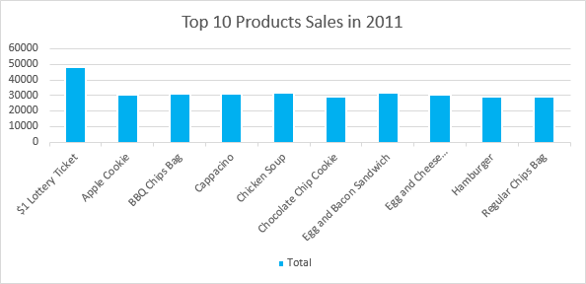
ANALYSIS ON DATA
TOP 10 PRODUCT SALES OF 2013
Product Name | Sum of TOTAL 2013 SALES
$1 Lottery Ticket | 49663
Apple Cookie | 31707
BBQ Chips Bag | 32026
Cappacino | 32391
Chicken Soup | 32874
Chocolate Chip Cookie | 30429
Egg and Bacon Sandwich | 32617
Egg and Cheese Sandwich | 31482
Hamburger | 30301
Regular Chips Bag | 30342
Grand Total | 333832
TOP 10 PRODUCT SALES OF 2011
Product Name | Sum of TOTAL 2011 SALES
$1 Lottery Ticket | 48238
Apple Cookie | 30678
BBQ Chips Bag | 31065
Cappacino | 31417
Chicken Soup | 31887
Chocolate Chip Cookie | 29653
Egg and Bacon Sandwich | 31723
Egg and Cheese Sandwich | 30643
Hamburger | 29471
Regular Chips Bag | 29427
Grand Total | 324202

Slide 8
Product Name | Sum of TOTAL 2011 SALES | Sum of TOTAL 2012 SALES | Sum of TOTAL 2013 SALES
Baconburger | 16968 | 17135 | 17492
Bottled Propane | 3007 | 3038 | 3101
Cappacino | 31417 | 31730 | 32391
Cheese Bread | 14717 | 14865 | 15085
Cheese Pizza Slice | 17039 | 17208 | 17521
Cheeseburger | 27005 | 27274 | 27836
Chicken Soup | 31887 | 32206 | 32874
Chili | 11618 | 11736 | 12027
Coffee | 21263 | 21474 | 21931
Crossaint | 10519 | 10624 | 10852
Egg and Bacon Sandwich | 31723 | 32042 | 32617
Egg and Cheese Sandwich | 30643 | 30952 | 31482
Egg and Ham Sandwich | 25887 | 26149 | 26720
Egg and Sausage Sandwich | 28922 | 29211 | 29737
Egg Roll | 24080 | 24322 | 25089
Hamburger | 29471 | 29764 | 30301
Hashbrowns | 13745 | 13885 | 14156
Hot Dog | 21964 | 22183 | 22906
Hot Tea | 5861 | 5922 | 6075
Mocha | 18545 | 18730 | 19143
Onion | 20723 | 20930 | 21349
Onionburger | 25706 | 25962 | 26527
Pepperoni Pizza Slice | 18343 | 18528 | 18850
Potato | 28192 | 28476 | 28959
Sausage Pizza Slice | 13128 | 13258 | 13509
Tomato Soup | 28161 | 28441 | 29129
Vegetable Soup | 11737 | 11856 | 12161
Grand Total | 562271 | 567901 | 579820

Slide 10
CONCLUSION :
The Product With Highest SALE Across 3 Years is $1 LOTTERY.
The product with lowest sale across 3 years is Nail Chipper.
The top 5 products with highest sales are $1 lottery ,apple cookie, BBQ chips bag, cappacino, chicken soup.
The total sales in 2011 is 1546491;
The total sales in 2012 is 1561961;
The total sales in 2013 is 1592082.

